Slide 1
Challenges in Integrating Data Analytics in Small Businesses
Submitted in the partial fulfillment for the award of the degree of
BACHELOR OF ENGINEERING
IN
Computer Science Engineering in Artificial Intelligence and Machine Learning
Submitted by:
SNEHA KUMARI - 21BCS5019
HEMANTHI NAIDU - 21BCS5239
Under the Supervision of:
Dr. Prianka Kaushik
Department of AIT-CSE
DISCOVER . LEARN . EMPOWER

Slide 2
Table of Contents
Introduction
System Architecture
Experimental Setup Design
Required Software
Research Methodology
Data Collection Plan
Feasibility Analysis
Innovative Elements in the Approach

Slide 3
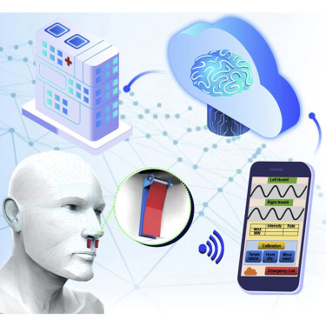
Introduction
Small businesses, despite their resource constraints, can benefit significantly from leveraging data-driven insights.
Enables businesses to make informed decisions, optimize processes, and identify growth opportunities.
For small businesses, data analytics can level the playing field by providing actionable insights that lead to better outcomes.
Helps small business owners make informed choices based on data rather than intuition.

Slide 4
System Architecture:
Limited resources: Lack of dedicated data analysts
Data quality issues: Inaccurate, incomplete, or inconsistent data
Data siloing: Data scattered across different systems and departments
Lack of technical expertise: Difficulty in understanding and applying analytical techniques
Resistance to change: Difficulty in adopting data-driven decision-making
Budget constraints:
Small businesses have limited funds
Lack of Data Governance Framework: Lack of security policies can lead to data misuse and security risks.
Time Constraints: The need for quick results can compromise data quality and analysis thoroughness.

Slide 5
Experimental Setup Design
Sample Selection:
Target Population: Small businesses in a specific industry or region.
Sampling Method: Random sampling, stratified sampling, or purposive sampling based on business size, industry, or geographic location.
Data Collection:
Surveys: Distribute online or paper-based surveys to collect information.
Case Studies: Analyse specific case studies of small businesses to identify challenges and solutions.
Data Analysis:
Quantitative Analysis: Use statistical methods to analyse survey data and identify patterns and trends.
Qualitative Analysis: Analyse interview transcripts and case studies to gain deeper insights into challenges and experiences.
Experimental Variables:
Independent Variables: Factors that may influence data analysis challenges, such as business size, industry, geographic location, level of technology adoption, and managerial experience.
Dependent Variables: Outcomes of data analysis challenges, such as business performance, decision-making quality, and competitive advantage.
Control Variables:
Factors that are held constant: These may include economic conditions, regulatory environment, and industry-specific trends.
Experimental Groups:
Control Group: Small businesses that do not receive any interventions or training related to data analysis.
Experimental Group: Small businesses that receive interventions or training to address data analysis challenges.

Slide 6

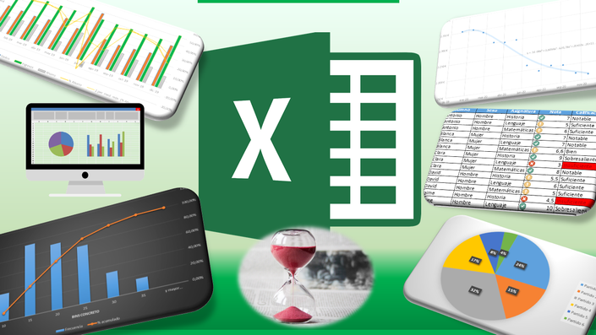
Required Software
Statistical Software: Python (with libraries like pandas, NumPy, and SciPy)
Qualitative Data Analysis Software: Power BI
Data Visualization Software: Tableau, Excel

Slide 7
Research Methodology
Research Design: Mixed-method approach combining quantitative and qualitative data.
Data Collection: Use structured surveys to gather data from small business owners and managers.
Qualitative Component: Conduct semi-structured data evaluation for in-depth insights.
Target Population: Small business owners, small - medium enterprises, and data professionals.
Sampling Method: Purposive sampling to include businesses with and without data analytics integration.
Sample Size: Aim for 50-100 survey responses and 10-15 in-depth review of research papers.
Quantitative Analysis: Use statistical techniques to identify common challenges.
Qualitative Analysis: Thematic analysis to uncover recurring barriers and enablers.
Ethical Considerations: Ensure confidentiality of the data.
Limitations: Recognize potential biases and the difficulty of generalizing across industries.

Slide 8
Data Collection Plan
Research Objectives: Identify the primary challenges faced by small businesses in implementing data analytics.
Paper-Based Surveys: Consider using paper-based surveys for businesses that may not have easy access to online tools.
Case Study Analysis: Analyze the case studies to identify common challenges and successful strategies.
Data Collection

Slide 9
Feasibility Analysis
Resource Availability:
Financial Resources: Assess the availability of funding for conducting the research, including survey distribution and data analysis software.
Human Resources: Evaluate the availability of researchers with the necessary expertise in data analysis, survey design, and qualitative research methods.
Time Resources: Determine the timeframe available for conducting the research, including data collection, analysis, and reporting.
Data Accessibility:
Survey Response Rates: Consider the potential response rates for surveys and the impact on sample size and representativeness.
Case Study Access: Determine the feasibility of obtaining access to case studies of small businesses implementing data analytics.
Ethical Considerations:
Informed Consent: Ensure that participants are informed about the research and provide voluntary consent.
Data Privacy: Develop measures to protect the privacy and confidentiality of data.

Slide 10
Innovative Elements in the Approach
Data-Driven Methodology:
Leverage Data Analytics: Employ data analytics techniques to analyze survey responses, interview transcripts, and case study data, providing deeper insights into the challenges and opportunities faced by small businesses.
Develop Predictive Models: Build predictive models to identify factors that influence the successful implementation of data analytics, enabling businesses to proactively address potential challenges.
1
2

